Slide 1
Meeting report integration criteria and fitting with photon dose
20170810

Slide 2
This is the point to pick

Slide 3
Fitting results

Slide 4
Fitting results
NSRRC | 3:2 | A | 3.07E+16 | 8.71E+14
 |  | B | 7.95E-19 | 4.92E-20
 |  | C | 4.13E+07 | 5.43E+31
 | 1:5 | A | 3.40E+16 | 1.76E+15
 |  | B | 5.58E-19 | 5.53E-20
 |  | C | 158609.3 | 1.42E+27
1:05 | 26-Apr | A | 4.73E+16 | 1.68E+15
 |  | k1 | 1.82E-18 | 1.41E-19
 |  | k2 | 1.21E-16 | 9.72E-17
 | 21-Apr | A | 4.53E+16 | 1.57E+15
 |  | k1 | 1.97E-18 | 1.57E-19
 |  | k2 | 6.69E-17 | 3.07E-17
 | 24-Apr | A | 4.33E+16 | 9.38E+14
 |  | k1 | 2.47E-18 | 1.46E-19
 |  | k2 | 5.28E-17 | 1.53E-17
 | average | k1 | 2.09E-18 | 3.42E-19
 |  | k2 | 8.02E-17 | 3.59E-17
1:20 | 8-May | A | 3.35E+16 | 1.33E+15
 |  | k1 | 1.21E-18 | 1.13E-19
 |  | k2 | 9.23E-17 | 1.17E-16
 | 10-May | A | 3.49E+16 | 1.43E+15
 |  | k1 | 9.83E-19 | 7.96E-20
 |  | k2 | 1.25E-16 | 1.58E-16
 | average | k1 | 1.10E-18 | 1.64E-19
 |  | k2 | 1.09E-16 | 2.33E-17
1:10 | 29-Apr | A | 4.05E+16 | 2.33E+15
 |  | k1 | 1.57E-18 | 1.80E-19
 |  | k2 | 1.86E-16 | 3.28E-16
 | 28-Apr | A | 3.62E+16 | 2.16E+15
 |  | k1 | 1.96E-18 | 2.71E-19
 |  | k2 | 4.61E-17 | 2.60E-17
 | 27-Apr | A | 3.92E+16 | 2.48E+15
 |  | k1 | 1.95E-18 | 2.95E-19
 |  | k2 | 2.13E-17 | 6.65E-18
 | average | k1 | 1.82E-18 | 2.22E-19
 |  | k2 | 8.43E-17 | 8.85E-17
3:2 | 12-Apr | A | 1.64E+16 | 1.98E+14
 |  | k1 | 8.00E-18 | 5.30E-19
 |  | k2 | 8.86E-17 | 3.32E-17
 | 14-Apr | A | 1.74E+16 | 2.44E+14
 |  | k1 | 6.38E-18 | 2.84E-19
 |  | k2 | 105450 | 4.97E+25
 | 17-Apr | A | 1.75E+16 | 2.14E+14
 |  | k1 | 6.96E-18 | 2.82E-19
 |  | k2 | 17646.75 | 1.18E+24
 | average | k1 | 7.11E-18 | 8.18E-19
 |  | k2 | 4.10E+04 | 5.65E+04

Slide 6
NSRRC 3:2 data 20170711
Notes:
The two fits overlapped with each other and hence it is a one step fit.

Slide 7
Interpolation for 50 points in the first 5e17 photons cm⁻²
Notes:
The two fits overlapped with each other and hence it is a one step fit.

Slide 8
Paste the points after 5e17 for 5 times
Notes:
The two fits overlapped with each other and hence it is a one step fit.

Slide 10
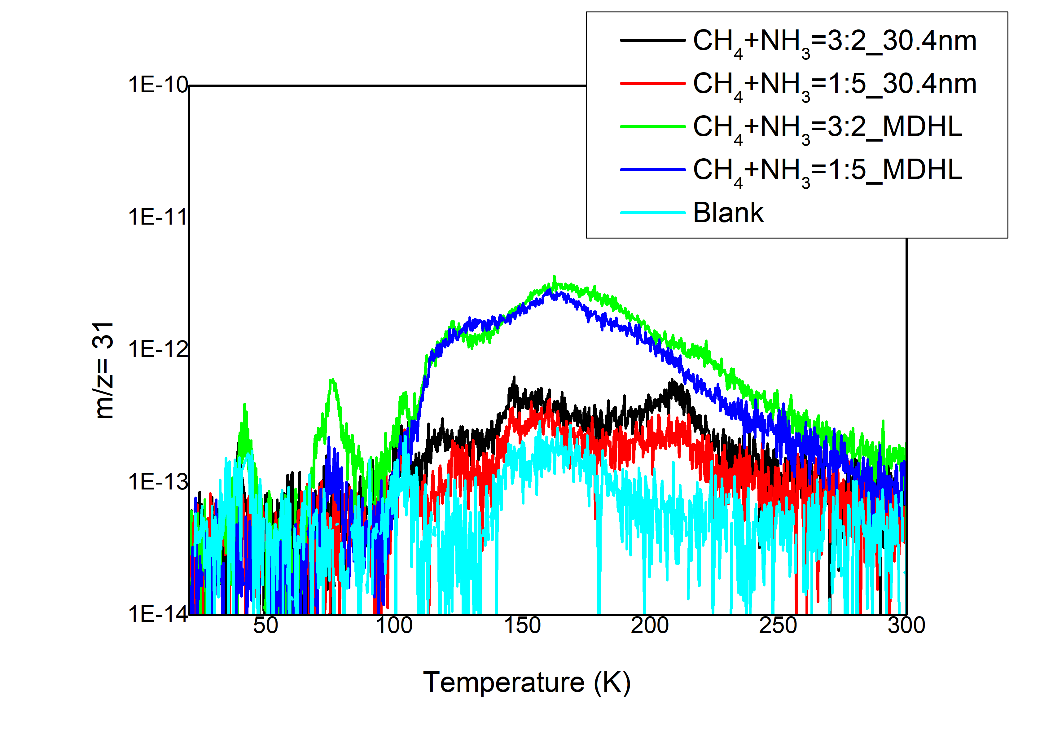
Absence of methylamine m/z=31
The RGA signals of methylamine is much lesser than at lab. (m/z=31, 120 K)
It shows that CN⁻ is not formed by methylamine and a one step production is expected.

Slide 17
Conclusion
By fitting with consecutive rate equations
K₁ descending when concentration of CH₄ decreases
K₂ increasing when concentration of CH₄ decreases
The RGA of NSRRC has absence in Methylamine explains this fitting results

Slide 22
Weird to be two step…

Slide 24
One step fitting

Slide 25
One step

Slide 26
CH₄+NH₃+H₂O=5:3:4

Slide 29
For CH₄+NH₃+H₂O=5:3:4
I use two step reaction to fit the OCN⁻ formation because OCN⁻ is formed by CO + HNCO and CO should be formed first
however, the second day, the CO is much lesser than first day.
We believe it is because of low signal to noise ratio because the 1cm-1 spectrum can overlap very well.
So we decided to repeat experiment with 4cm⁻¹ 128 scan to get better signals.
It shows that, the production of OCN⁻ with MDHL is the same as NSRRC.
date | ratio | k₁ | k₂ | k₂/k₁ | deviation with previous day (%)
20170713 | 5:3:4 on CaF₂ | 0.00383 | 0.22319 | 58.27415
20170714 | 5:3:4 on CaF₂ | 0.00438 | 0.0651 | 14.86301 | 6.70%
20170715 | 5:3:4 on CaF₂ | 0.00444 | 0.05171 | 11.6464 | 0.68%
lab | 5:3:4 on KBr | 0.00509 | 0.06039 | 11.86444

Slide 30
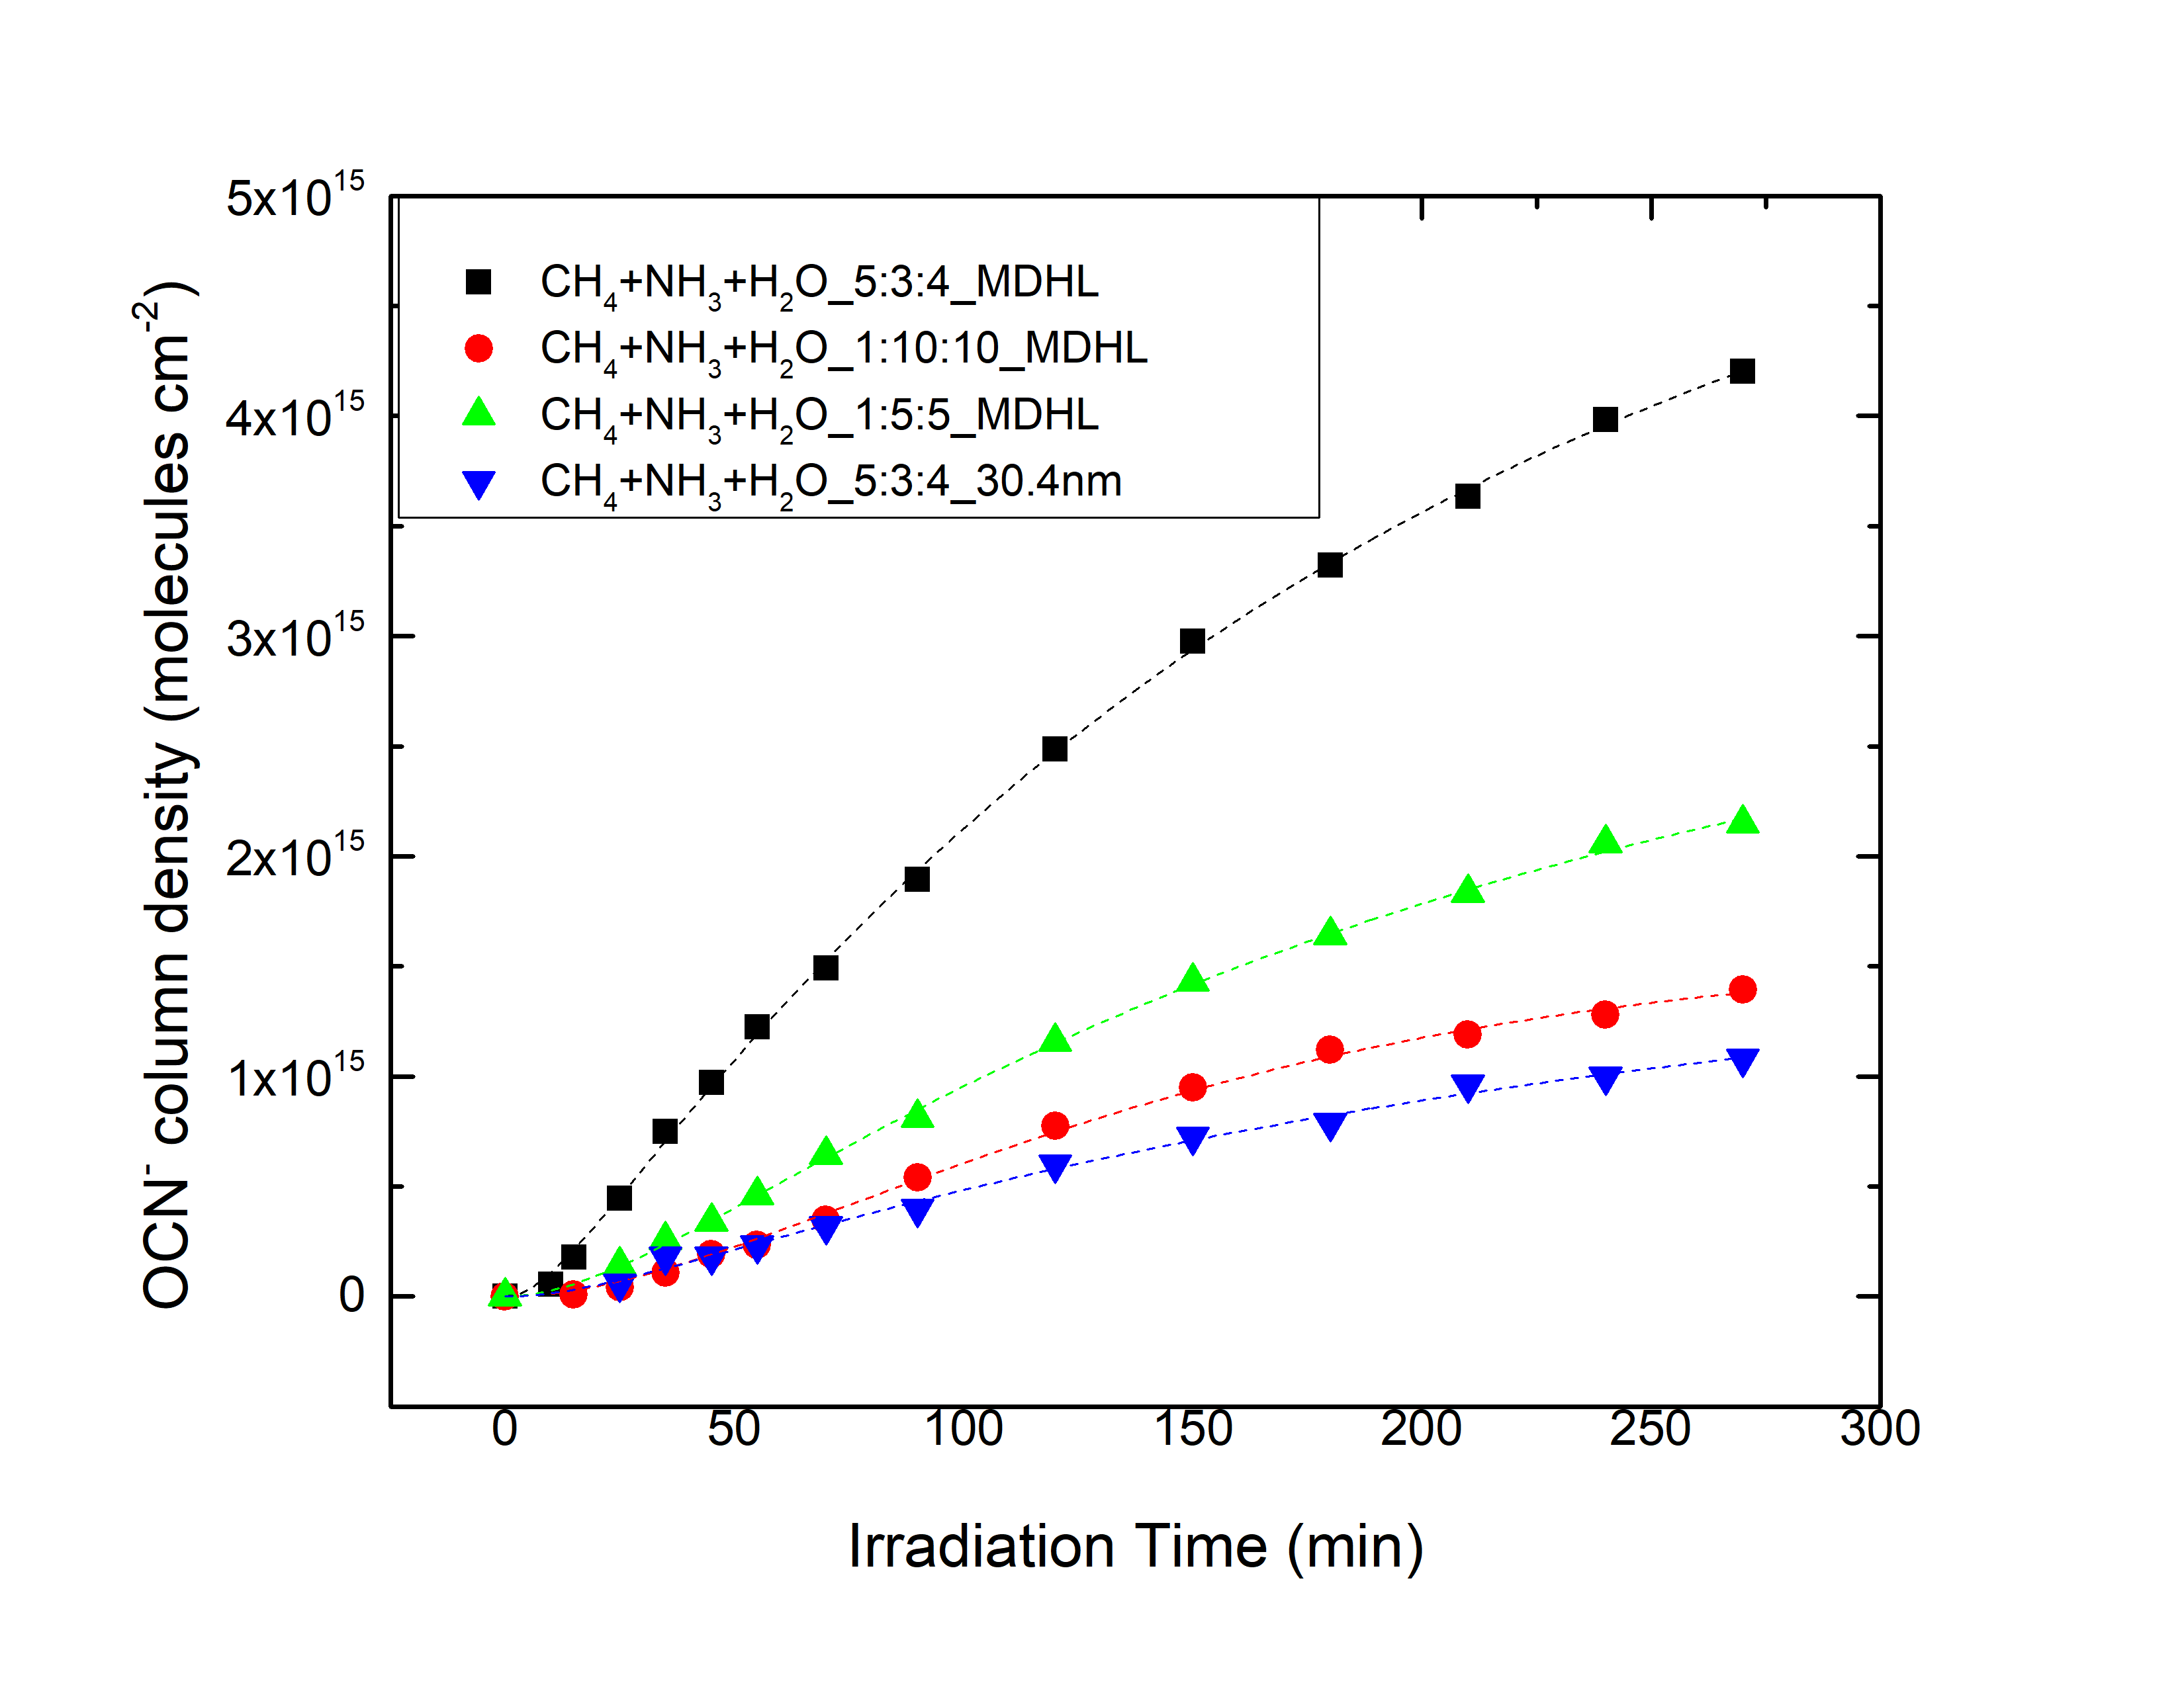
OCN⁻ production comparison with Lab
The production rate constants are similar to lab, the yield is similar to 1:10:10 by MDHL.
MDHL NSRRC

Slide 31
CO CO₂ and OCN⁻

